Slide 1
MODULE IV Expert System and Learning B.Tech.(CSE), VII Artificial Intelligence (CSE 401) Introduction of Expert System and it’s Architecture
Amity School of Engineering and Technology

Slide 2
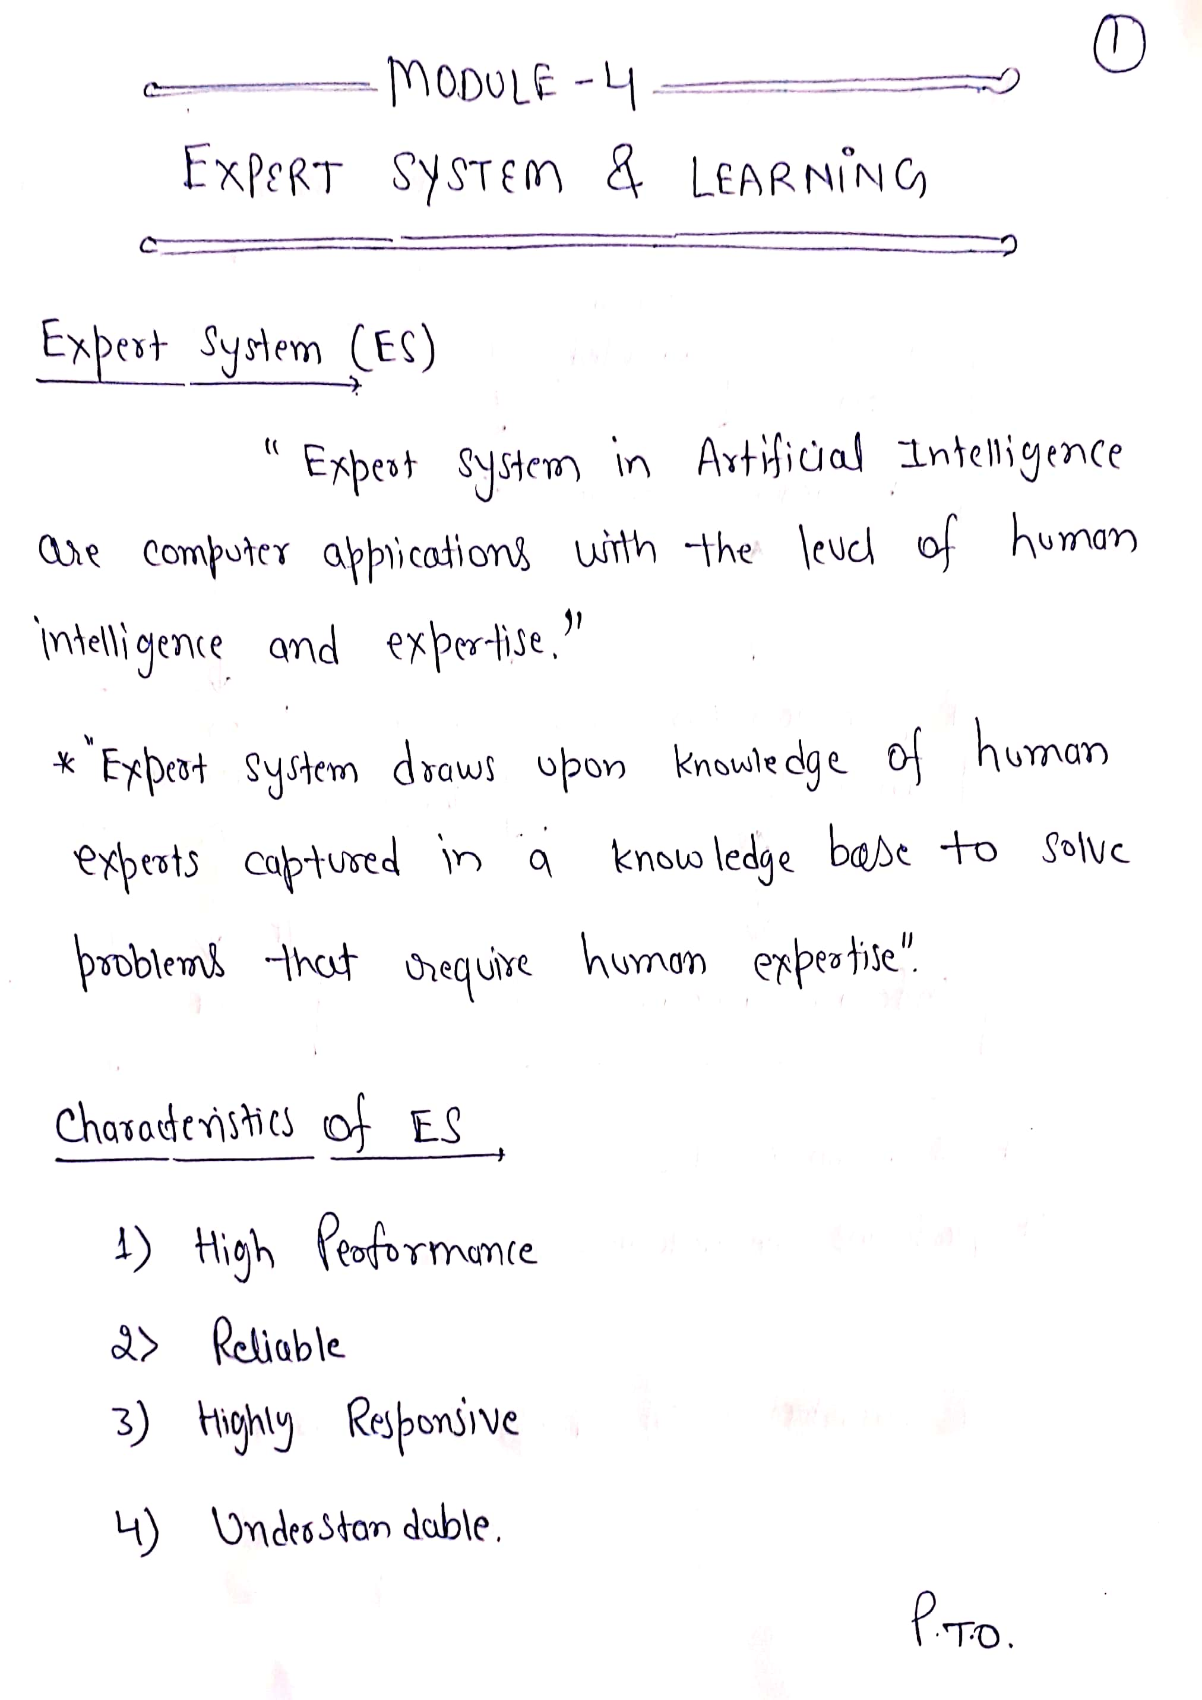

Slide 3
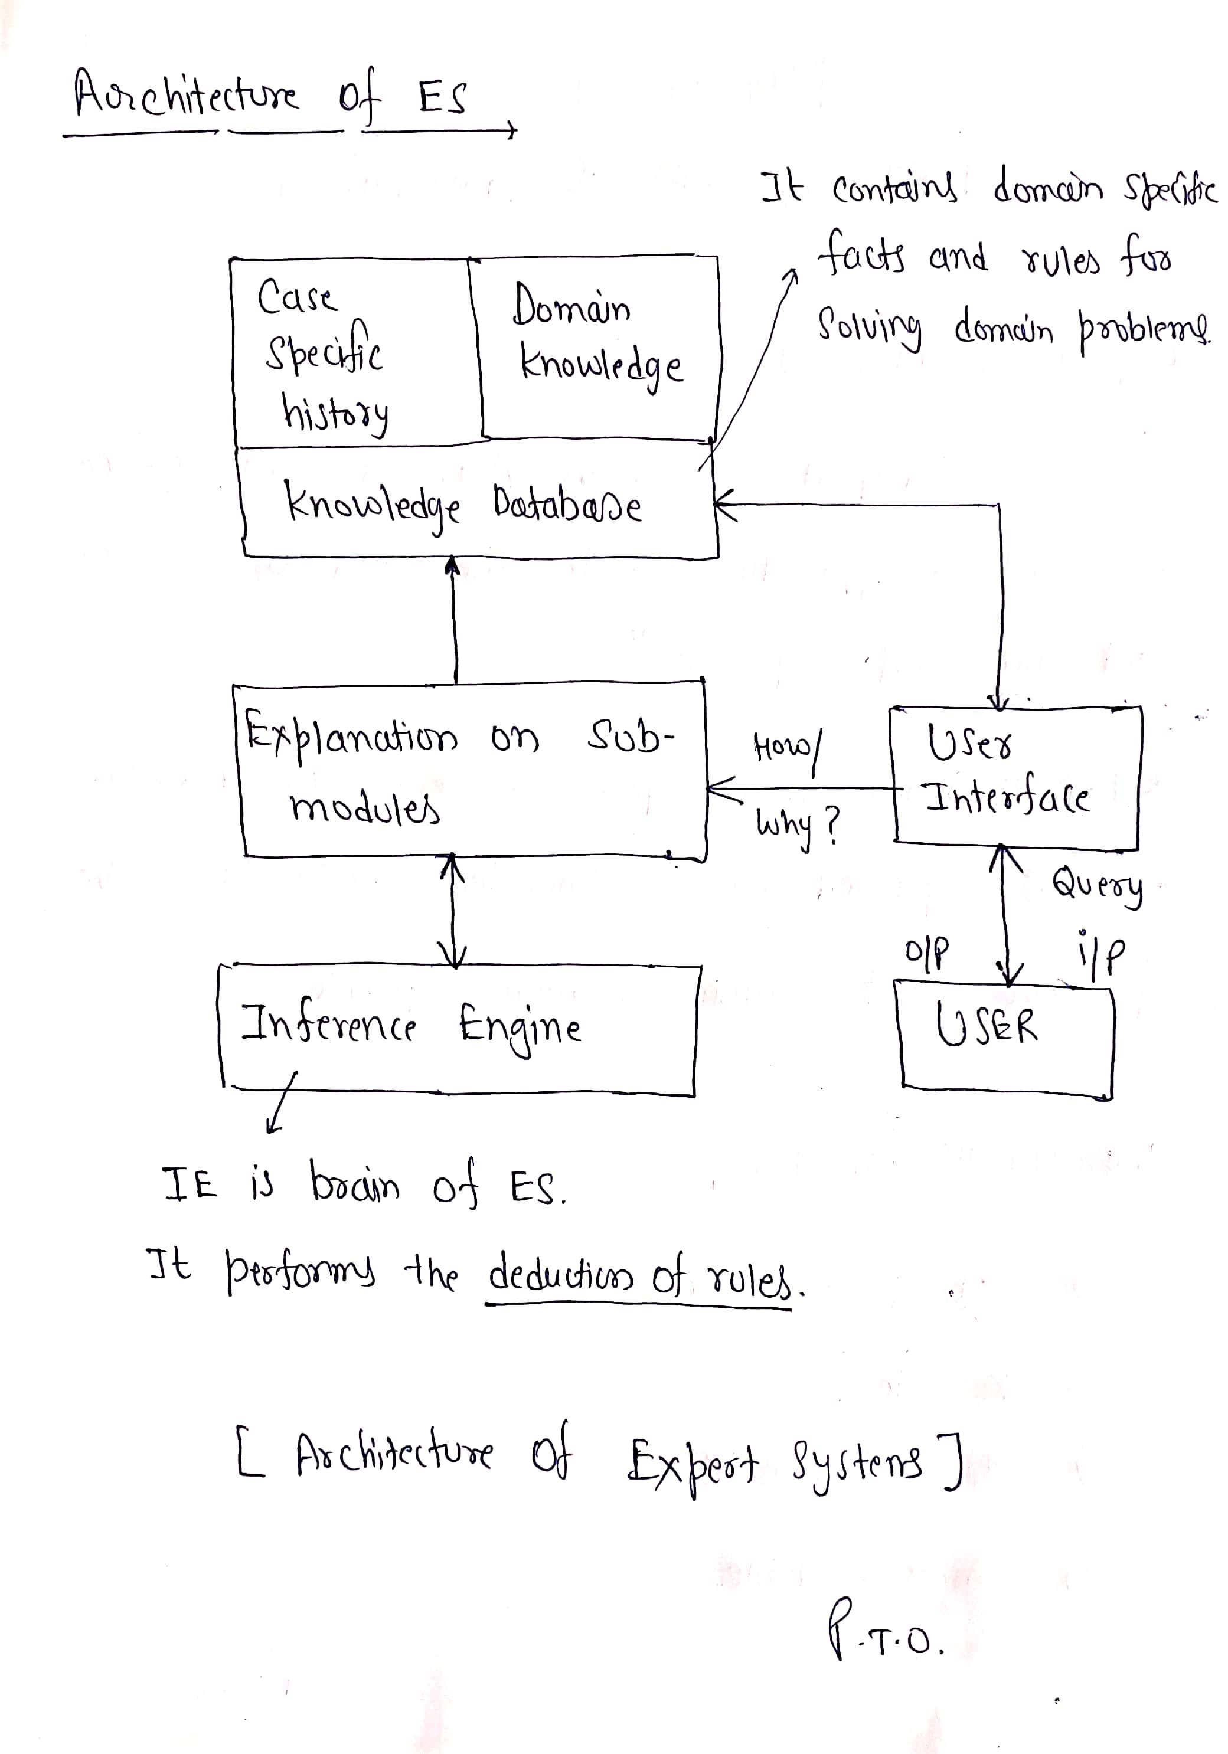

Slide 4
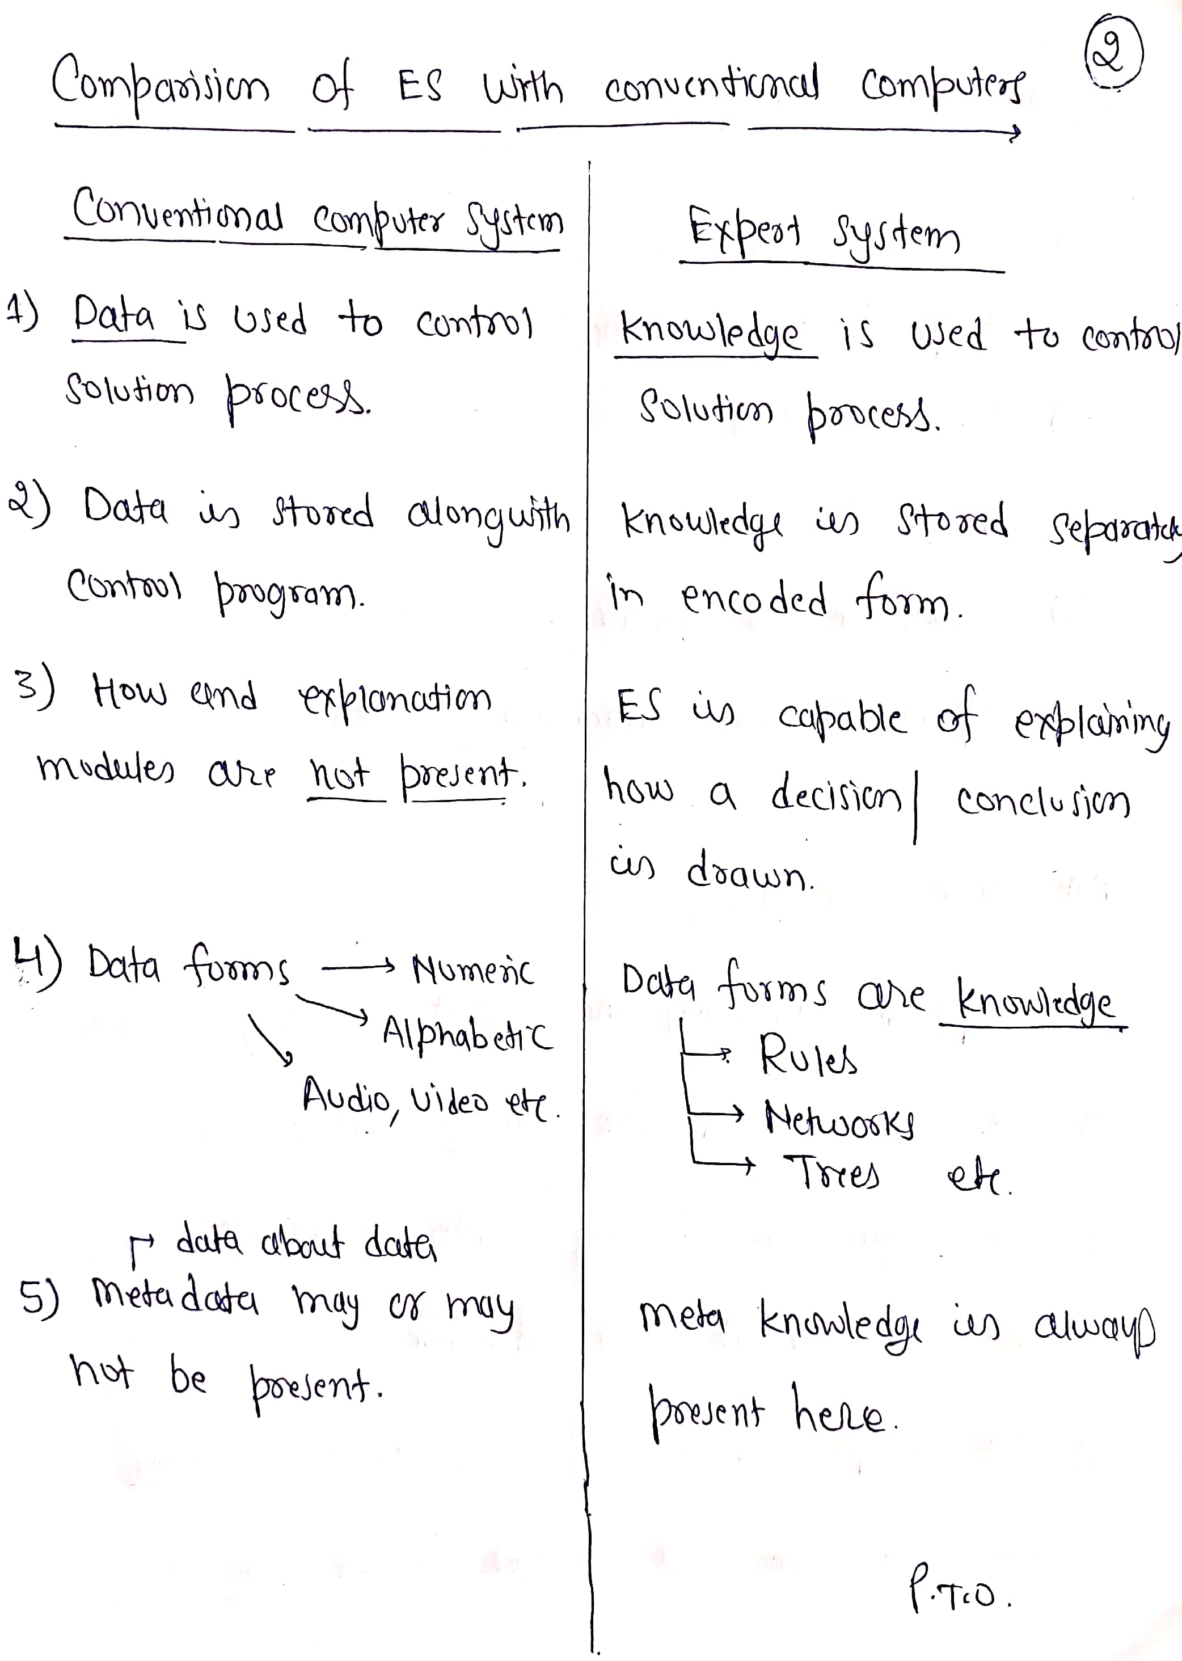

Slide 5
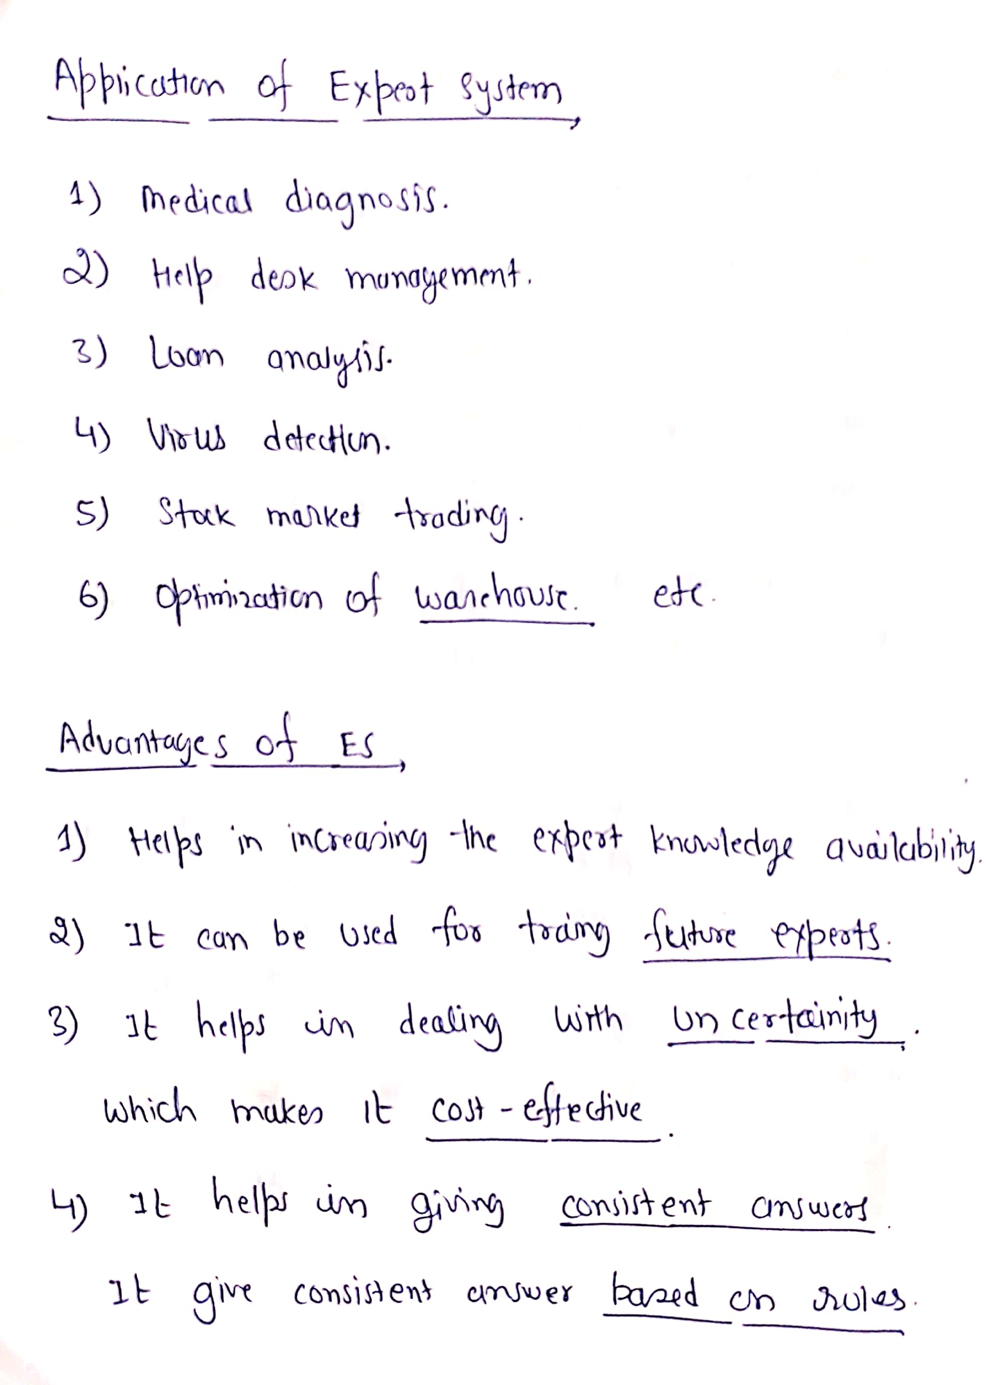

Slide 6
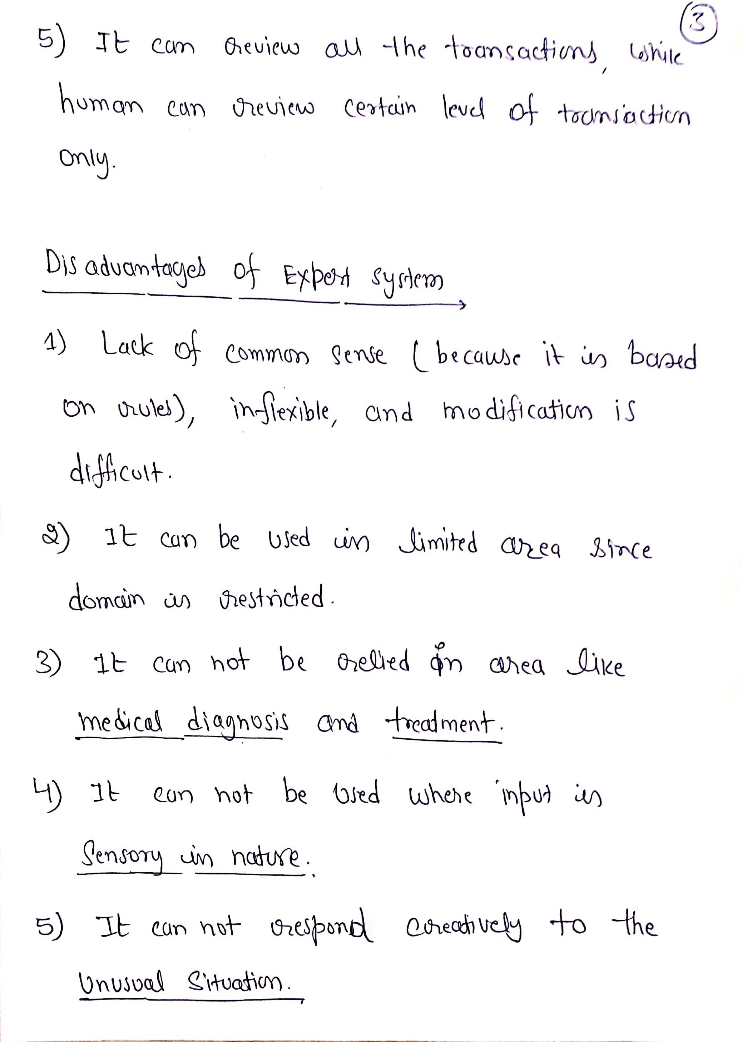

Slide 7
What is an expert system?
“An expert system is a computer system that emulates, or acts in all respects, with the decision-making capabilities of a human expert.”
Professor Edward Feigenbaum
Stanford University

Slide 8
Expert systems aimed to capture specialist human expertise which was in short supply. Eg..,
– Medical expertise
– Computer configuration expertise.
– Expertise for oil exploration.
Aim was to develop systems capturing this expertise, so the knowledge could be deployed where experts were unavailable.
Expert system (ES) are knowledge intensive programs that solve problems in a domain that requires considerable amount of technical expertise.

Slide 9
An Expert System (ES) is a computer-based system (mainly software) that uses knowledge and facts, and apply an appropriate reasoning technique (inferencing) to solve problems in a given field (domain) that normally require the services of human experts.

Slide 10
Need & Justification for expert systems- cognitive problems
Expert systems are suitable for knowledge intensive problems that are typically solved by human experts.
Because expert systems depend on human knowledge, if human experts are unable to solve a given problem, no successful expert system can be developed to solve the problem either.
When the demand for human expertise surpasses the availability of experts, an expert system may be the tool for handling the situation.
The justification of using an expert system for a selected problem depends on the primary goal of the organization and the types of alternatives available.

Slide 12
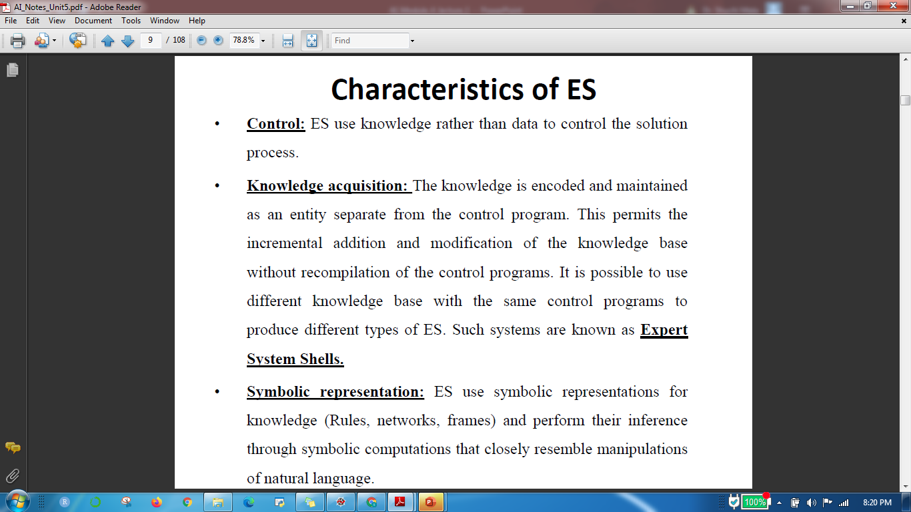
Characteristics of Expert System

Slide 13
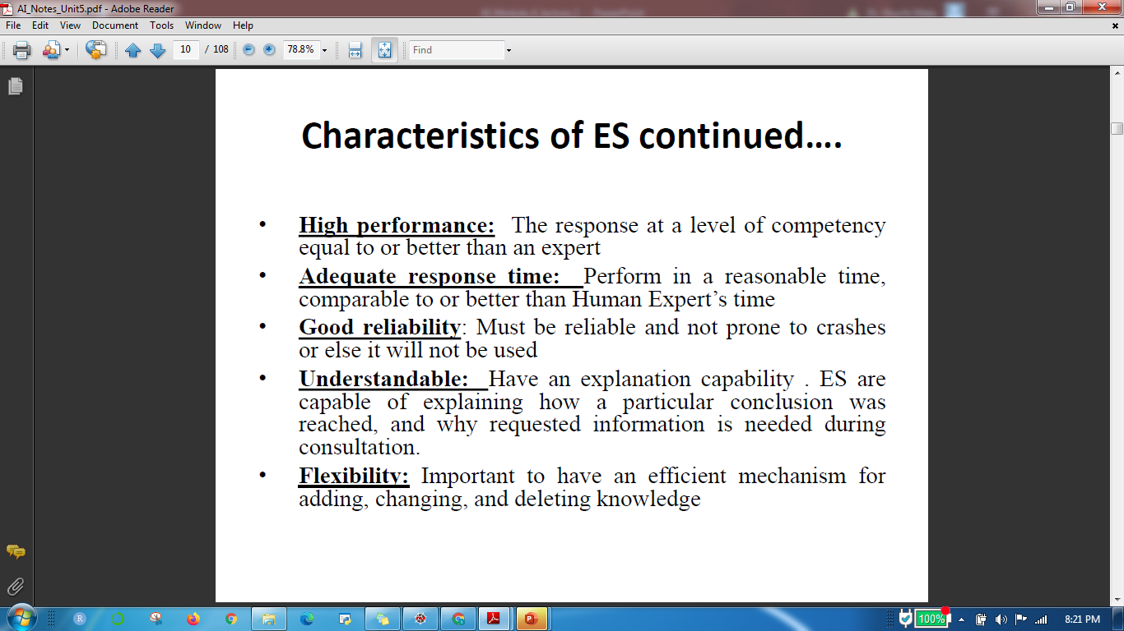

Slide 14
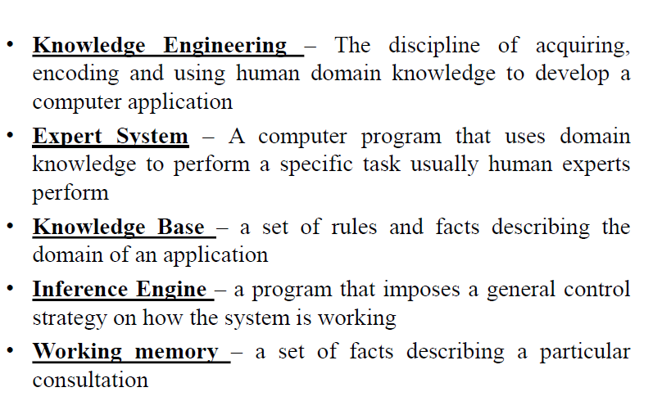
Basic Concept of ES

Slide 15
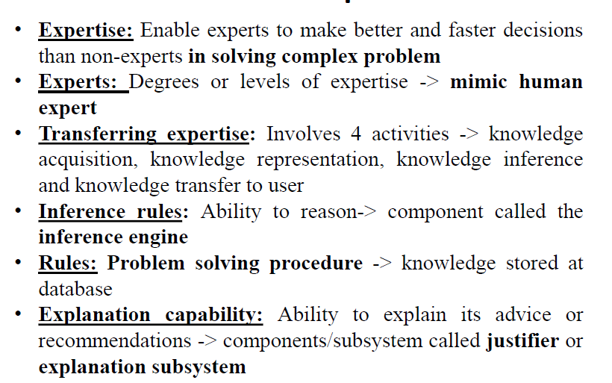

Slide 16
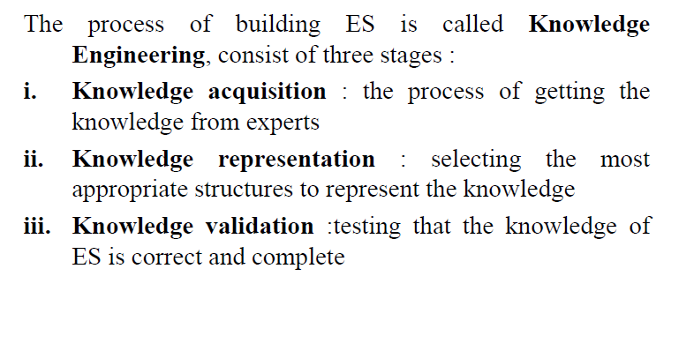
Designing Expert System

Slide 17
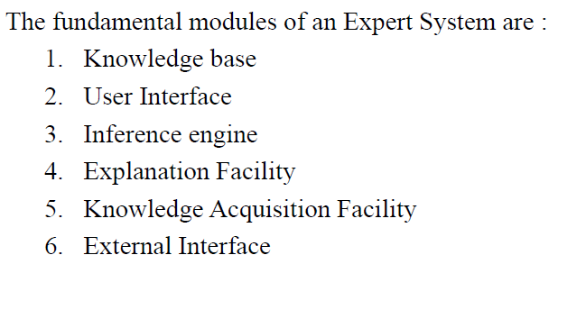
Architecture of Expert System

Slide 18
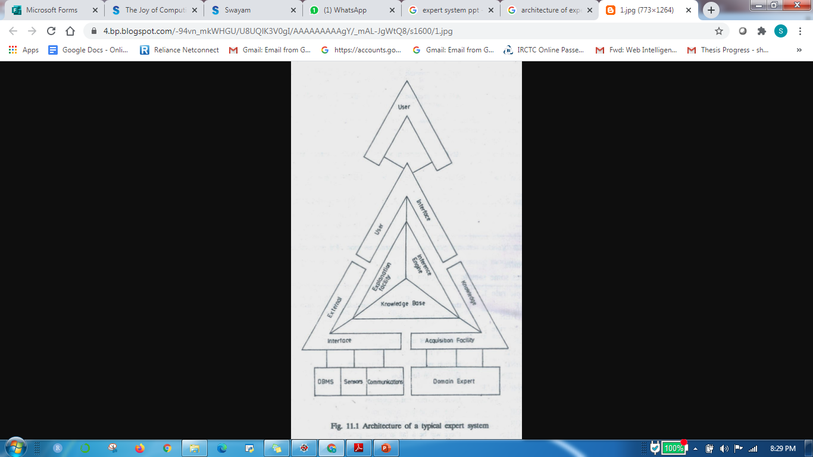

Slide 19
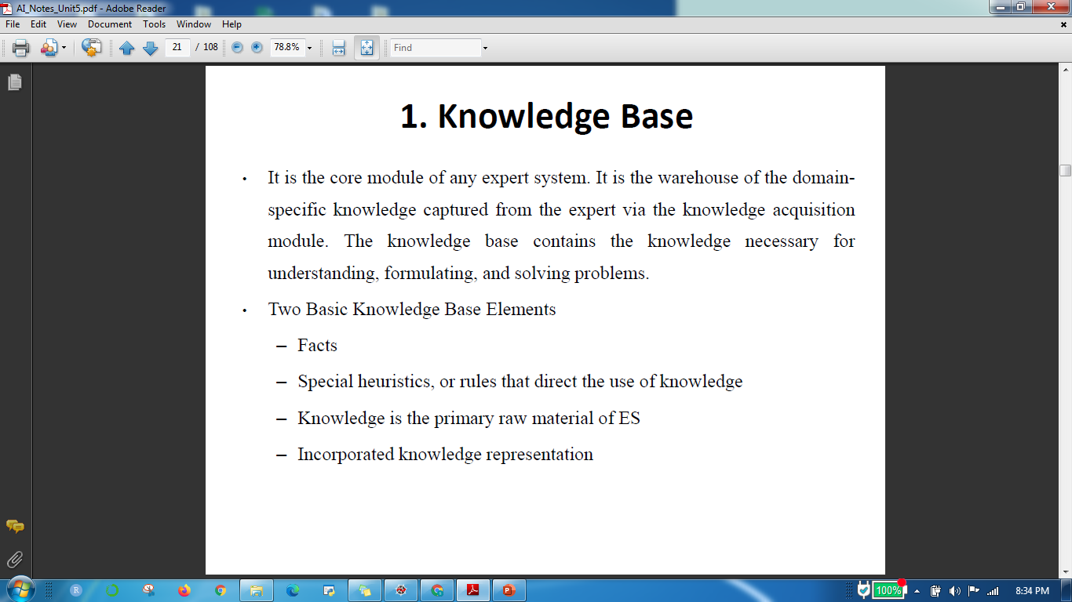
1. Knowledge Base

Slide 20
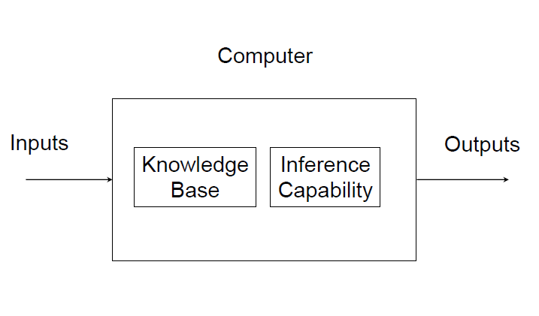
Using the Knowledge Base

Slide 21
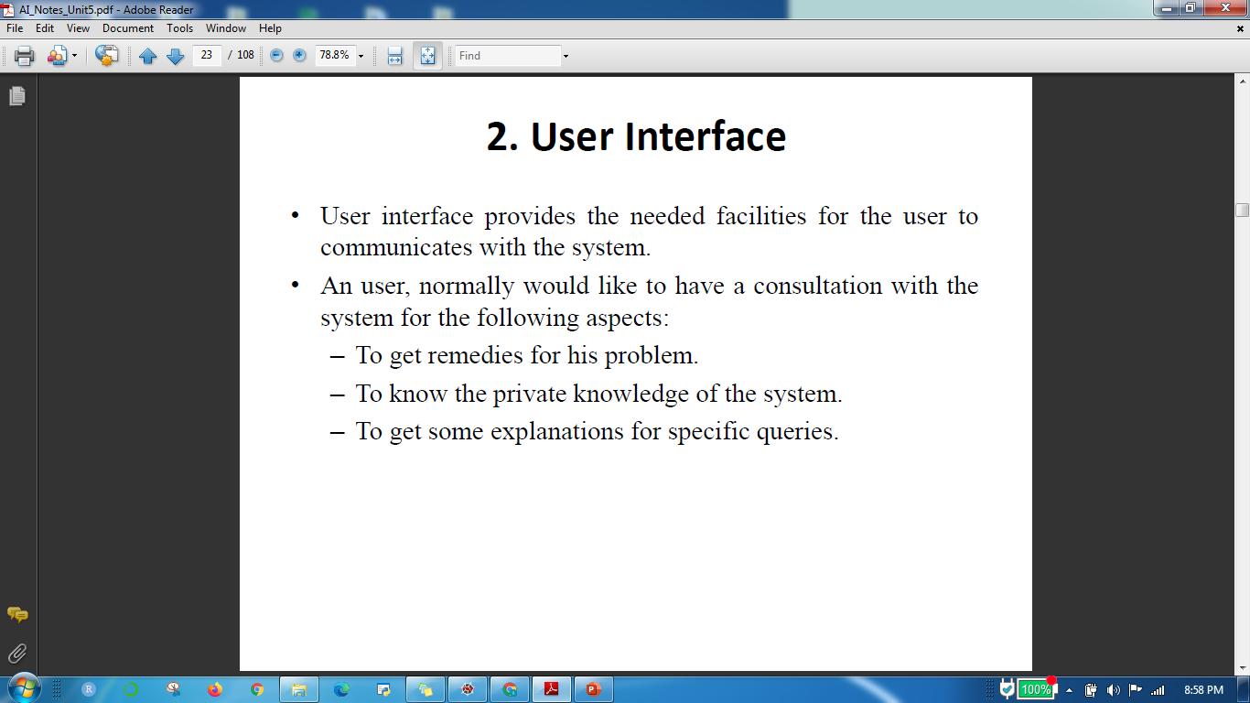
2. User Interface

Slide 22
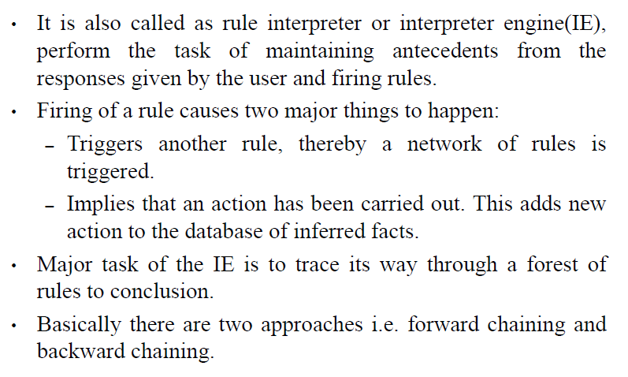
3. Inference Engine

Slide 23
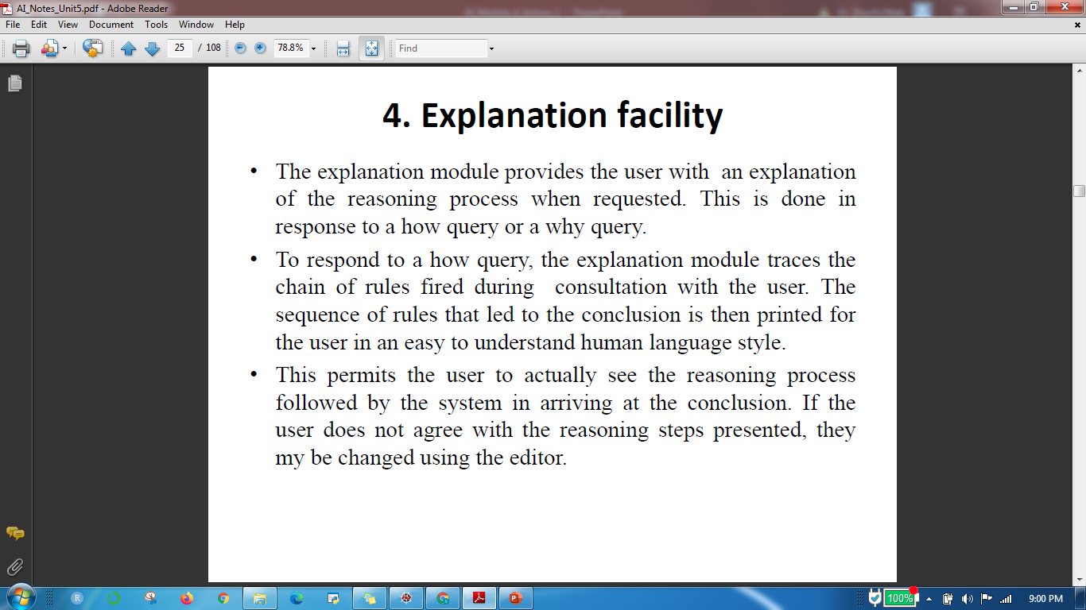
4. Explanation facility

Slide 24
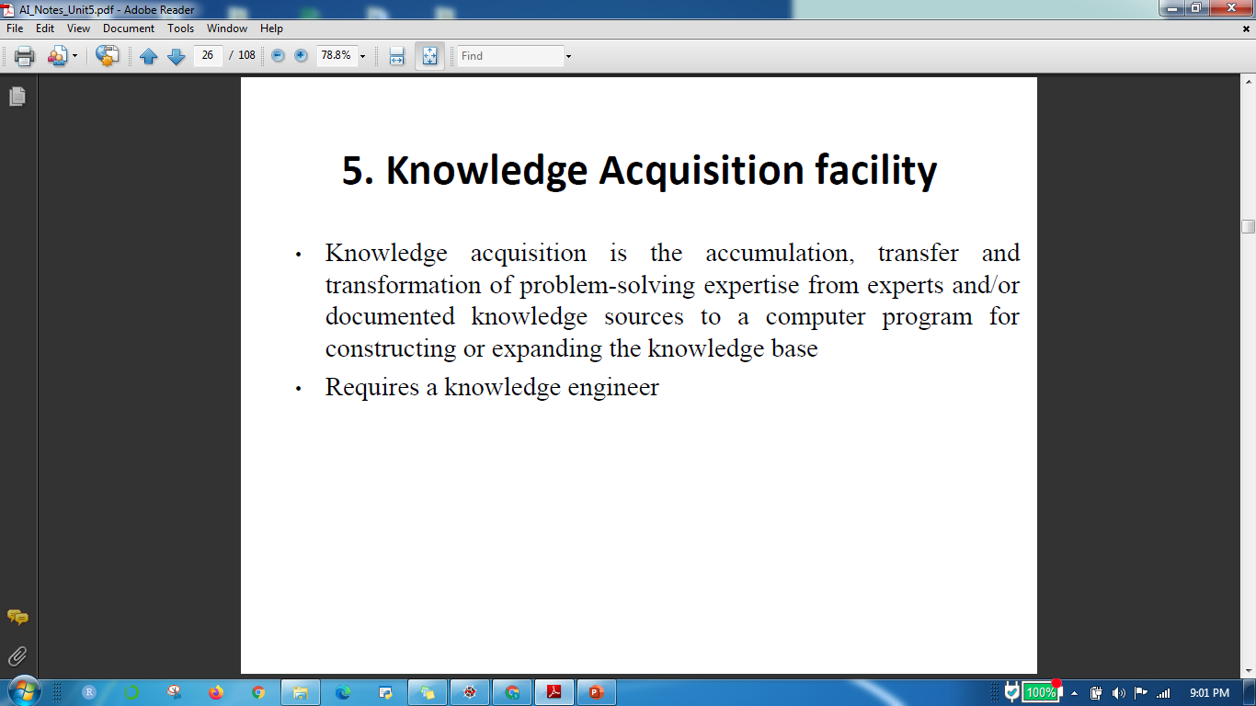
5. Knowledge Acquisition facility

Slide 25
6. External interface
This provides the communication link between the ES and the external environment.

Slide 26
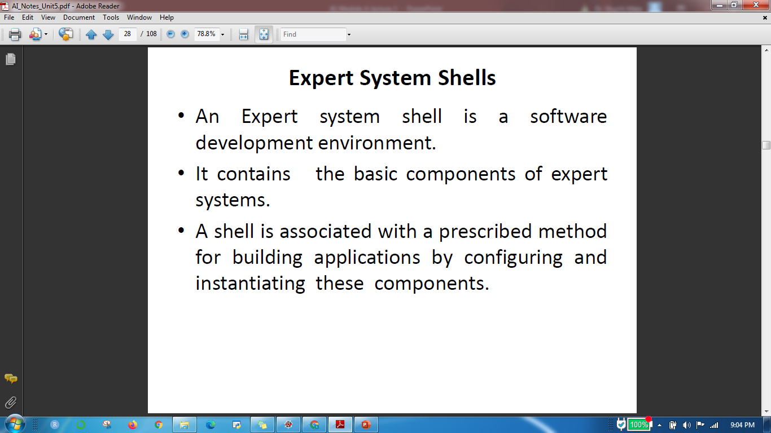
Expert System Shells

Slide 27
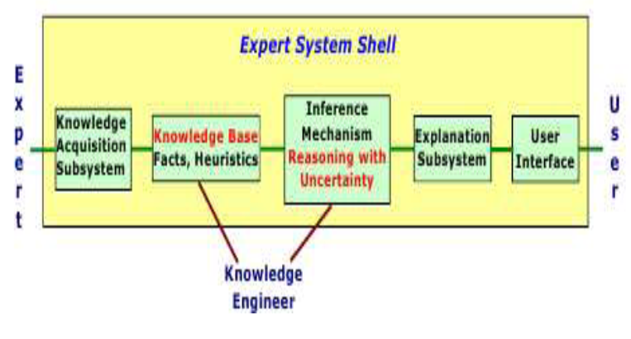
Expert System Shells

Slide 28
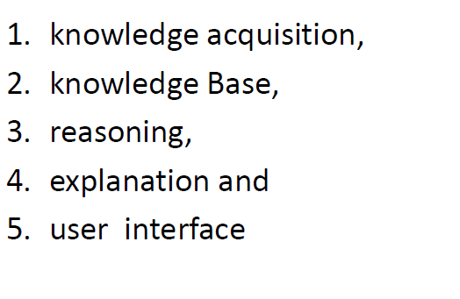
Shell components

Slide 29
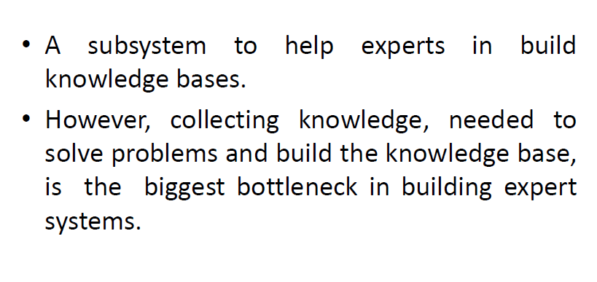
Knowledge Acquisition

Slide 30

Knowledge Acquisition

Slide 31
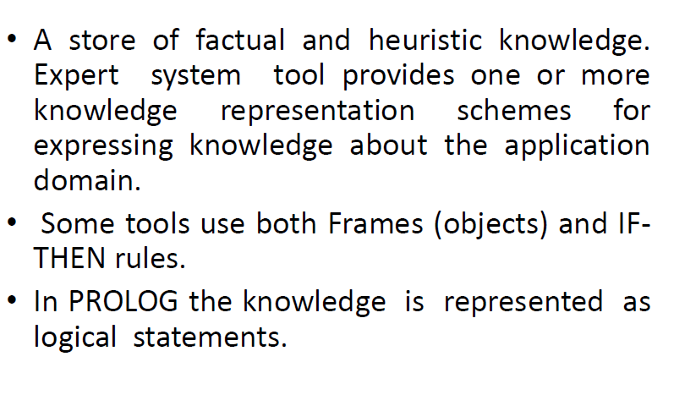
Knowledge Base

Slide 32
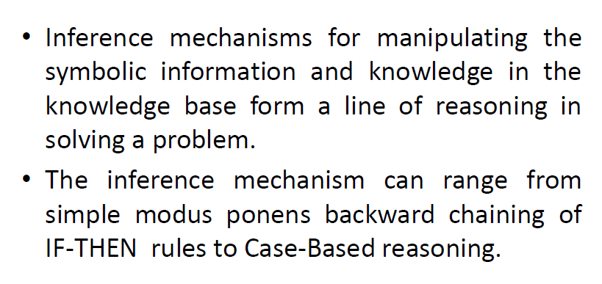
Reasoning Engine

Slide 33
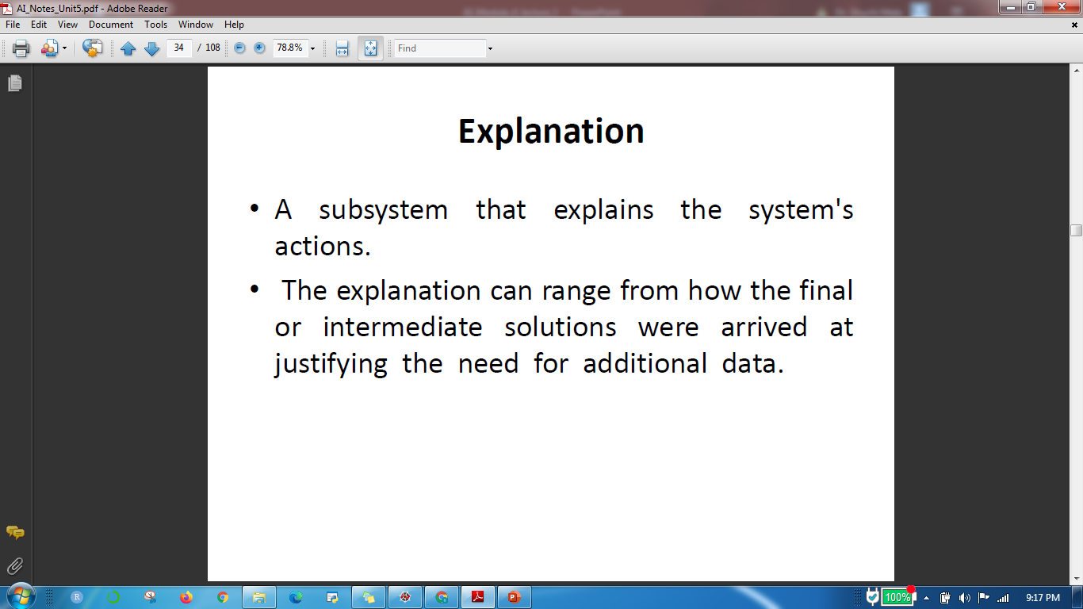
Explanation

Slide 34
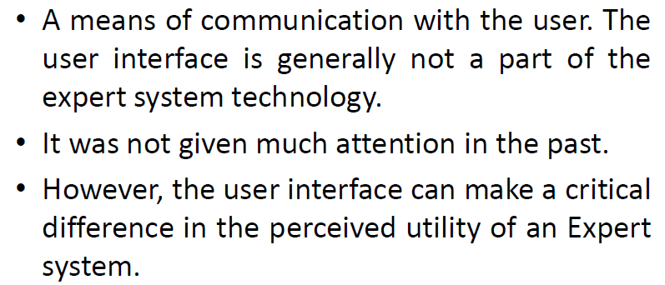
User interface

Slide 35
Rule based system architecture
The most common form of architecture used in expert and other types of knowledge based system is the production system, also called the rule-based system.
This type of system uses knowledge encoded in the form of production rules, that
is, if ….then rules.
Each rule represents a small chunk of knowledge relating to the given domain of expertise.
A number of related rules collectively may correspond to a chain of inferences which lead from some initially known facts to some useful conclusions.
When the known facts support the conditions in the rule’s left side, the conclusion or action part of the rule is then accepted as known.

Slide 36
Rule based system architecture
Inference in the production systems is accomplished by a process of chaining through the rules recursively, either in a forward or backward direction, until a conclusion is reached or until failure occurs.
The selection of rules used in the chaining process is determined by matching current facts against the domain knowledge or variables in rules and choosing among a candidate set of rules the ones that meet some given criteria, such as specificity.
The inference process is typically carried out in an interactive mode with the user providing input parameters needed to complete the rule chaining process.

Slide 37
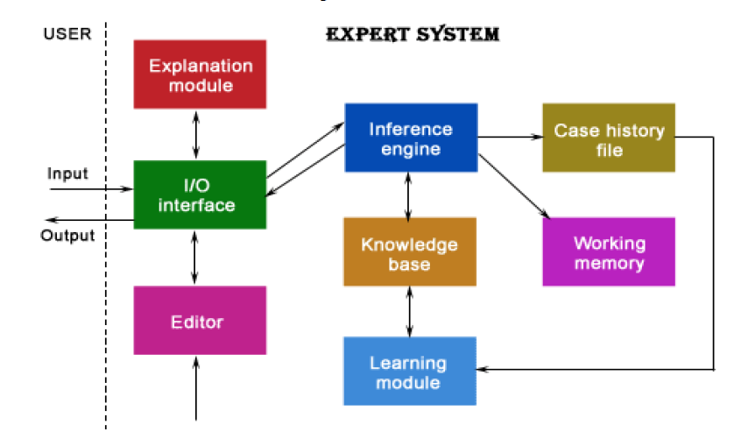
Rule based system architecture

Slide 38
Expert System Components And Human Interfaces
Expert systems have a number of major system components and interface with individuals who interact with the system in various roles.

Slide 39
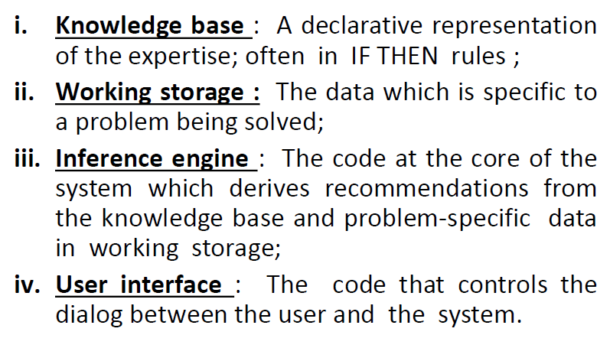
Components and Interfaces

Slide 40
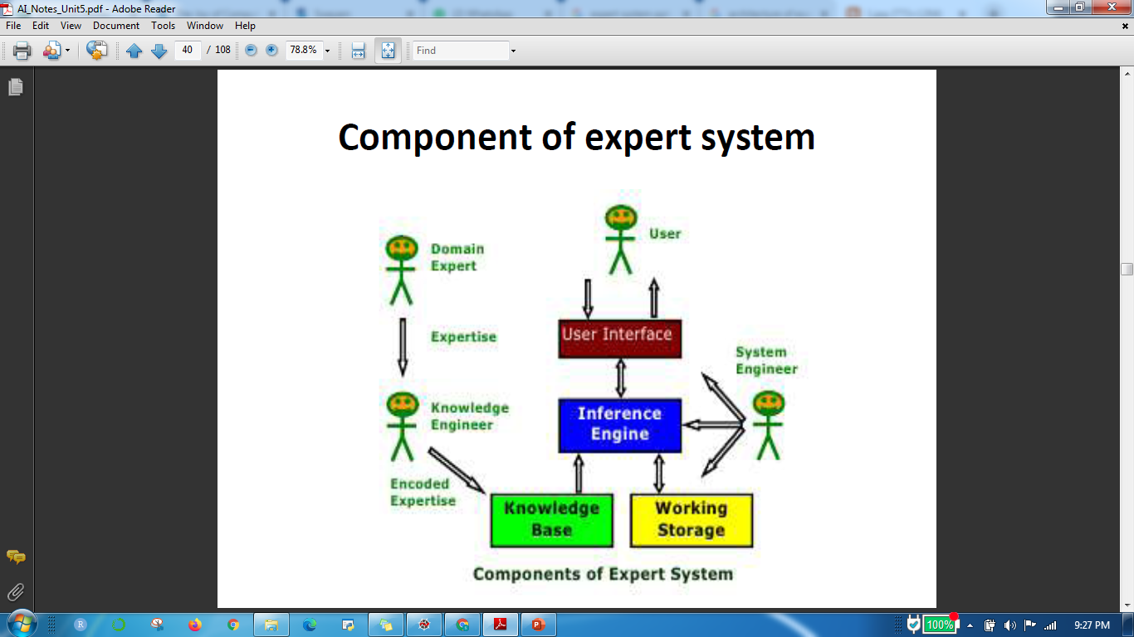
Component of Expert System

Slide 41
Thank You

